Slide 1
use perl or die;
Stefan Seifert

Slide 2
CiderWebmail
http://www.ciderwebmail.org

Slide 3
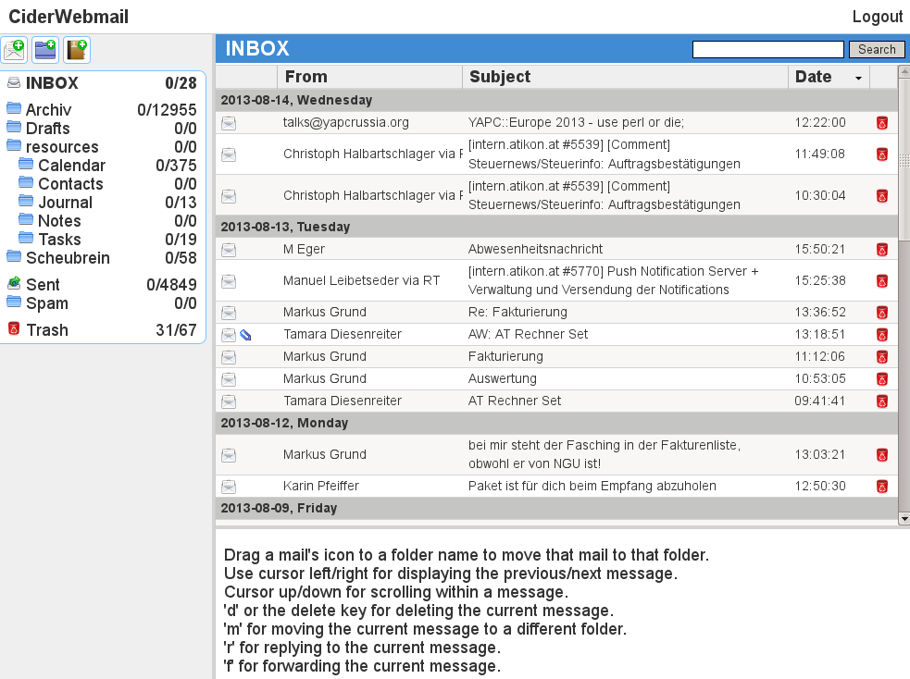

Slide 4
CiderCMS
http://www.cidercms.org

Slide 5
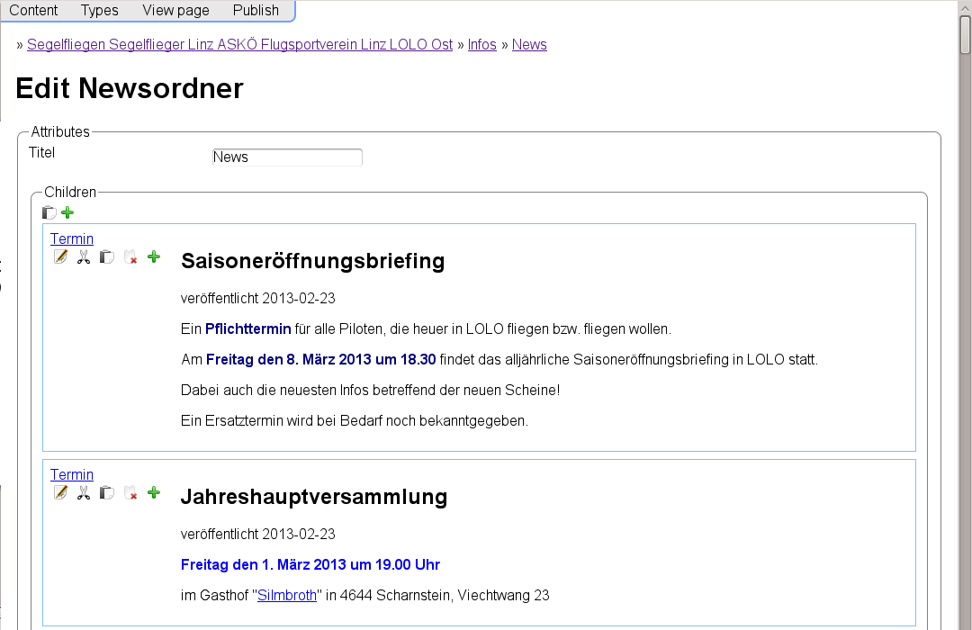

Slide 6
<unnamed> mailing list manager

Slide 7
Future: CiderWebstats?

Slide 8
http://www.ciderwebmail.org
http://www.cidercms.org

